Slide 1

OC – Project 7 Scoring model Implementation
Loan approval process
Stephane Lanchec – March 2022

Slide 2
Problem overview
"Prêt à dépenser" is a financial institution that give loans to people with insufficient or non-existent credit history.
Customer likely to repay
Loss of loan interests if not granted
2 risks associated
Customer not likely to repay
Financial loss if loan granted
MISSION
Implementation of a scoring model automatically predicting the probability for a customer to default
Creation of an interactive dashboard and deployment on a cloud platform
Be as transparent as possible with our customers in the loan decision process

Slide 3



OVERALL PROCESS
EDA
Deployment
Feature Engineering
Modeling
Variables understanding
Features distribution
Statistics
Data Type
Duplicates
Erroneous values
Nan values
New features creation
Aggregation (min, max, mean, sum, ratios…)
Encoding
Memory reduction
Imputation
Feature selection
BorutaPy
Performance benchmark - no optimization
Models selection
Optuna Hyperparameters Optimization
Adapted metric
Cost function
App framework for ML
web framework for building APIs
Could application plateform
Input
Data
* Based on Kaggle kernel of Rishabhrao
* Based on Kaggle kernel of Aguiar

Slide 4
DATASETs OVERVIEW
application_train.csv
(307511/122)
application_test.csv
(48744/121)
« Prêt a depenser »
TARGET
Other institutions
previous_application.csv
(1670214/37)
Application data of client’s previous loans with « Prêt a depenser »
bureau.csv
(1716428/17)
Application data from previous loans with other institutions
POS_CASH_balance.csv
(10001358/8)
Instalments_payment.csv
(13605401/8)
Monthly balance of client’s previous loans with « Prêt a depenser »
Past payment data from each instalment of previous credits with « Prêt a depenser »
bureau_balance.csv
(27299925/3)
Monthly balance of credits
Credit_card_balance.csv
(3840312/23)
Monthly balance of previous credit card loans with « Prêt a depenser »

Slide 5
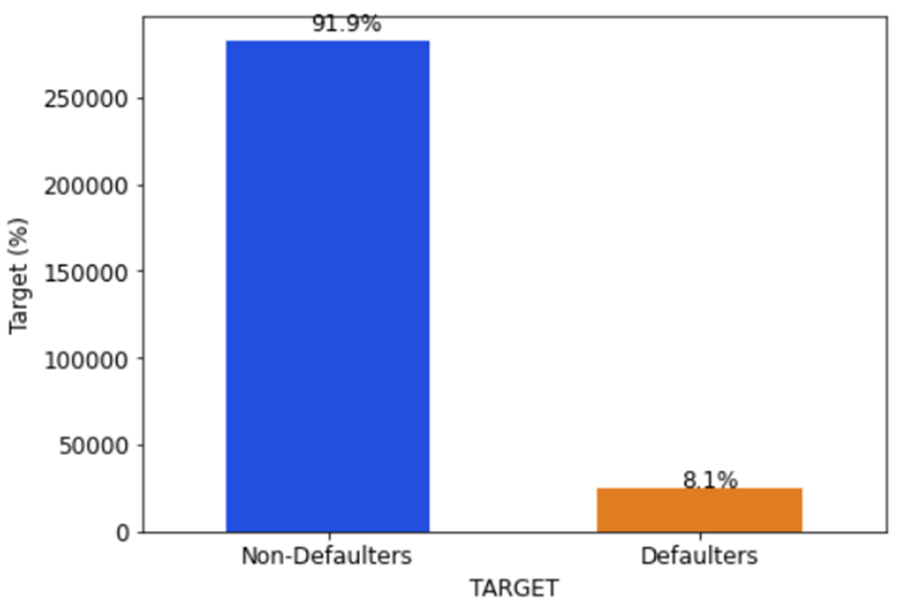
Data Analysis
Majority class
Features observations
Nan values, duplicates
Missing values
Data types, statistics
Correlated features
Class or target 0: Customers repay loan
Class or target 1: Customers with payment difficulties
Problem of Imbalanced classification
Minority class
Modeling challenge: Most ML classification algorithms were designed around the assumption of an equal number of examples for each class.

Slide 6
Feature ENGineering & selection
Support of the Kaggle kernel from Aguiar
The following key ideas were used:
Data Aggregation (min, max, mean, sum…)
Divide or subtract important features to get rates (like annuity and income)
Create specific features for Active credits and Closed credits
Create specific features for Approved and Refused applications
One-hot encoding for categorical features
Merge datasets using the SK_ID_CURR key (except bureau_balance)
1 dataset of 633 features
Boruta Feature Selection
All relevant feature selection method
Find all features carrying information usable for prediction
633 features
Full model
Boruta
87 features
Ltd model
Train model faster
Reduce complexity of the model
Reduce over-fitting by selecting optimal features

Slide 7
MODELING

Slide 8
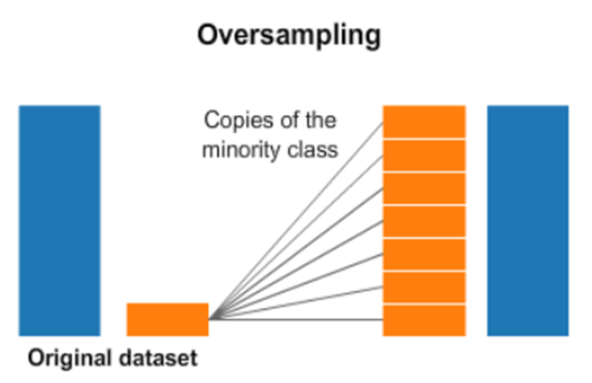
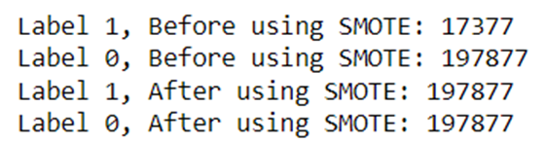
Imbalanced classification
Class 0
Classes not represented equally
Can result in models with poor predictive performance specifically for the minority class
Class 1
Tactics to Combat Imbalanced Classes
Balance of the class distribution with SMOTE
Duplicates examples from the minority class in the training dataset prior to fitting the model
LGBM class_weight = « balanced » - The model automatically assigns the class weights inversely proportional to their respective frequencies.

Slide 9
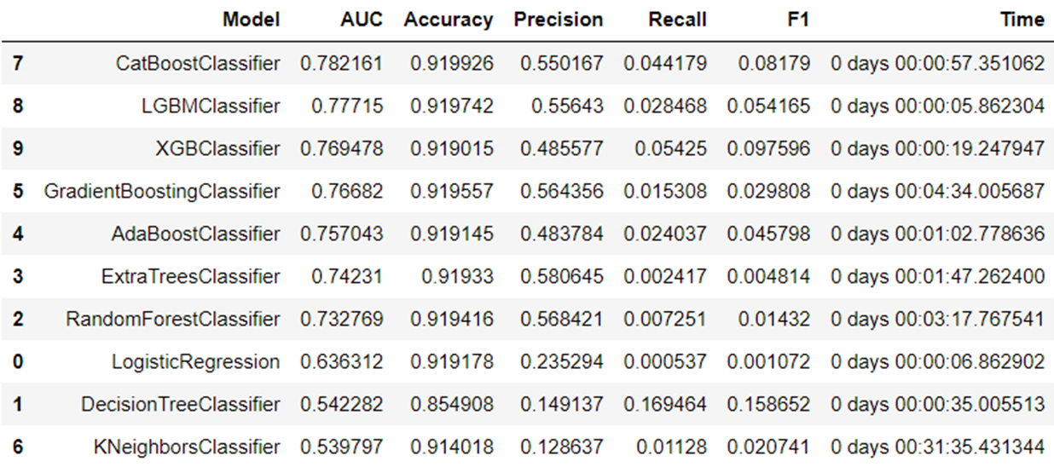
Model selection – no optimization
Investigation of different models (ala Pycaret)
Gross model – No hyperoptimization
Performance evaluated
Consideration of different metrics
Combination of performance + run time
Focus on LGBMClassifier

Slide 10
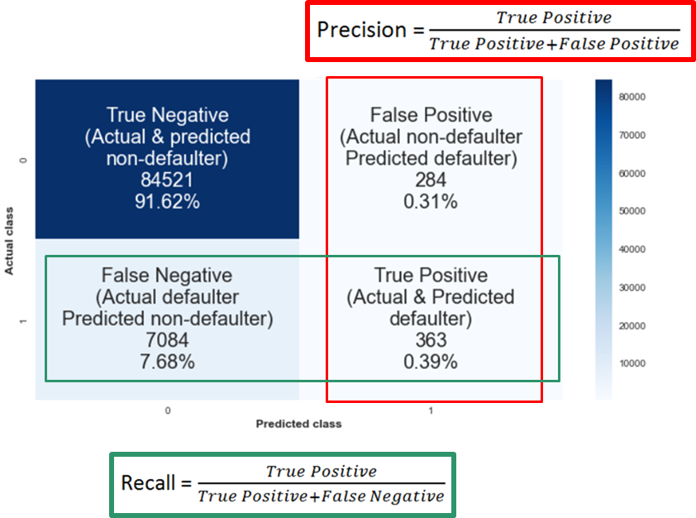
Modeling – Adapted metric
False Positive: Denying a loan to a good customer marked as a bad customer
=
Loan Interests loss for the bank
PRECISION talks about how precise/accurate our model is out of those Predicted defaulters (FP+TP), how many of them are True positive
Class 0: Non-defaulter
Class 1: Defaulter
Maximize Precision
=
Minimize FP
Maximize Recall
=
Minimize FN
False Negative: Giving a loan to a bad customer marked as a good customer
=
High cost for the bank
RECALL calculates how many of the Actual defaulters (FN+TP) our model capture through labeling it as True Positive

Slide 11
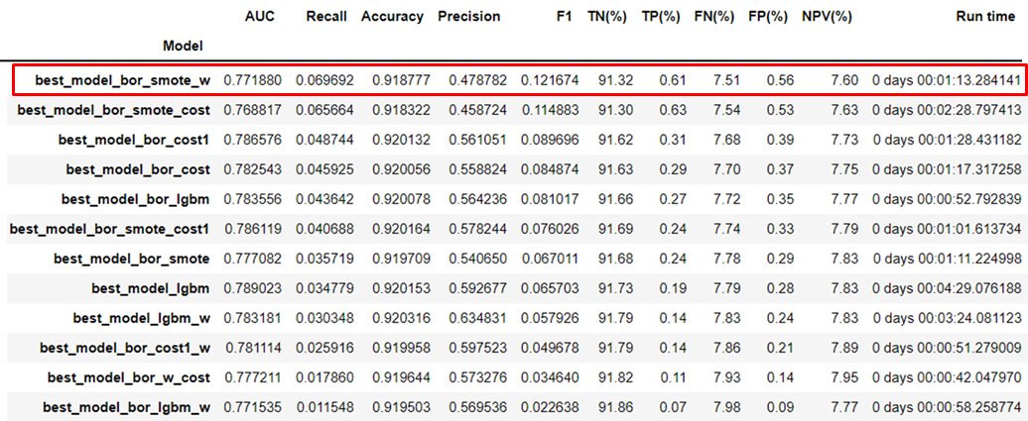
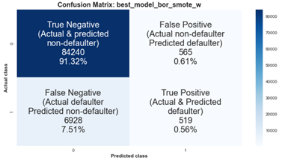
Best model
Best model:
LightGBM with our features selected model
Class redistribution with SMOTE
LGBM class_weight = ‘balanced’
Hyperparameters optimization via Optuna
Based on best RECALL metric
Hyperparameter | Default value | Best value
n-estimators | 100 | 10000
learning_rate | 0.1 | 0.126241
num_leaves | 31 | 1180
max_depth | -1 | 12
min_data_in_leaf | 20 | 200
lamba_l1 | 0 | 40
lambda_l2 | 0 | 20
min_gain_to_split | 0 | 0.451879
bagging_fraction | 1 | 0.60000
bagging_freq | 0 | 1
feature_fraction | 1 | 0.9
class_weight | None | balanced
How to read models name
bor = selected features dataset
smote = class distribution through SMOTE
w = LGBM class_weight = ‘balanced ’
cost = custom metric
cost1 = custom metric 1

Slide 12

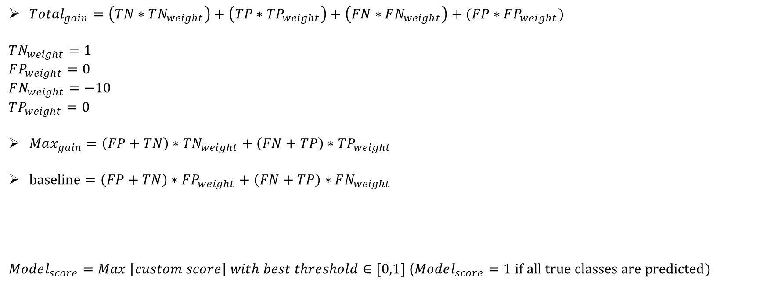
Cost function
Special cost function penalizing False Negatives to prevent the bank to lose too much money.
$Total_{gain}=\left(TN∗TN_{weight}\right)+\left(TP∗TP_{weight}\right)+\left(FN∗FN_{weight}\right)+(FP∗FP_{weight})$
$$TN_{weight}=1$$
$$FP_{weight}=0$$
$FN_{weight}=−10$
$$TP_{weight}=0$$
$Max_{gain}=\left(FP+TN\right)∗TN_{weight}+\left(FN+TP\right)∗TP_{weight}$
$baseline=\left(FP+TN\right)∗FP_{weight}+\left(FN+TP\right)∗FN_{weight}$
$Model_{score}=Max \left[custom score\right] with best threshold∈[0,1]$ ($Model_{score}=1 if all true classes are predicted)$
False Negative penalized
All predictions are correct
Every loan is refused, no money made
$$custom score=\frac{Total_{gain}−baseline}{Max_{gain}−baseline}$$
Greater is better

Slide 13

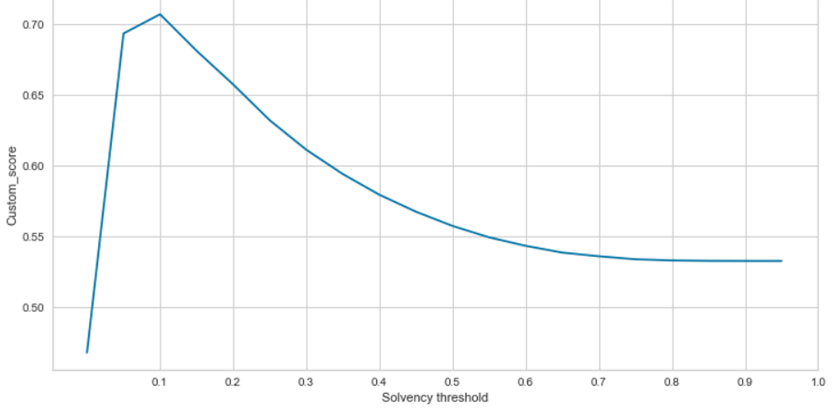
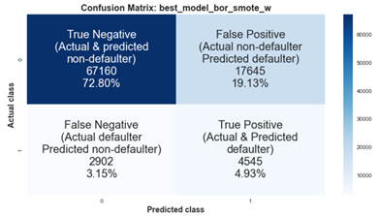
MODELING – custom metric impact
with Recall metric
Threshold determination optimizing custom score
with custom metric
Reduction of FN detected
Balance between FN & FP would need to be discussed

Slide 14
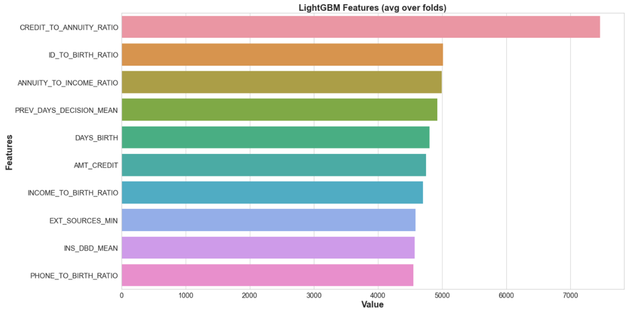
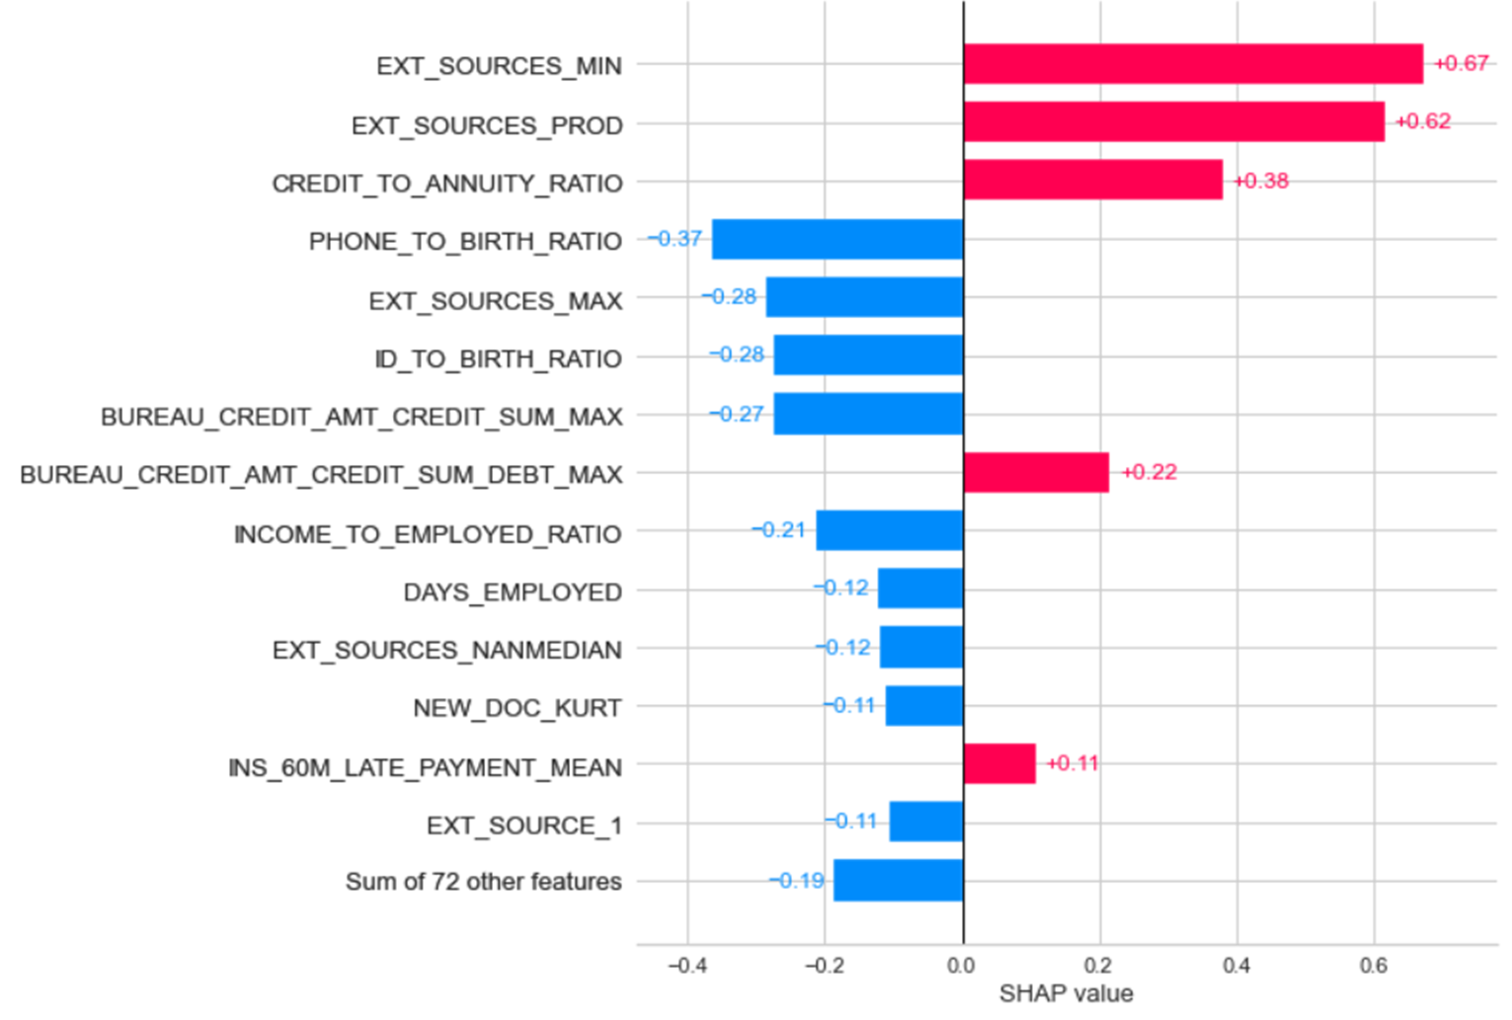
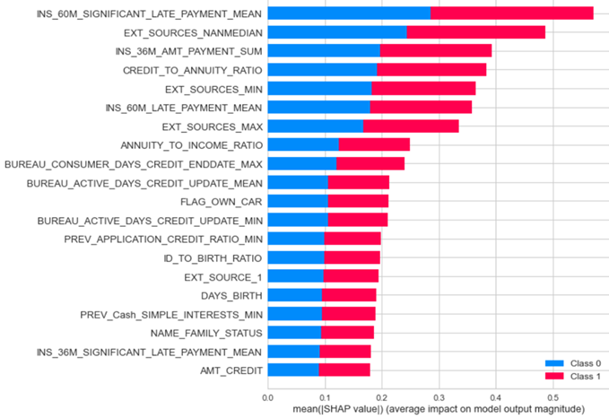
MODEL INTERPRetability
Global features importance - Impact of a feature on model fit
Local i.e. for a selected customer
Global shap values - Impact of a feature on predictions
Bar plot
SHAP values shown in red correspond to input variables that ’push’ the model towards predicting class 1 (defaulters) while those in blue push the model towards class 0 (non-defaulters)

Slide 15
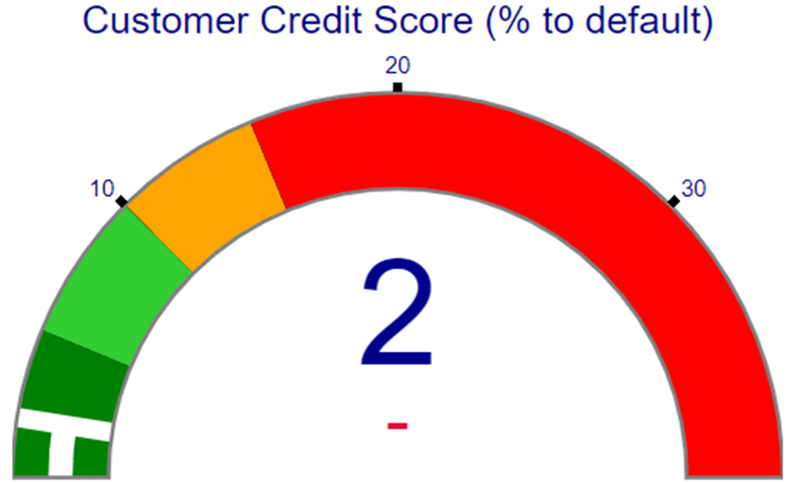
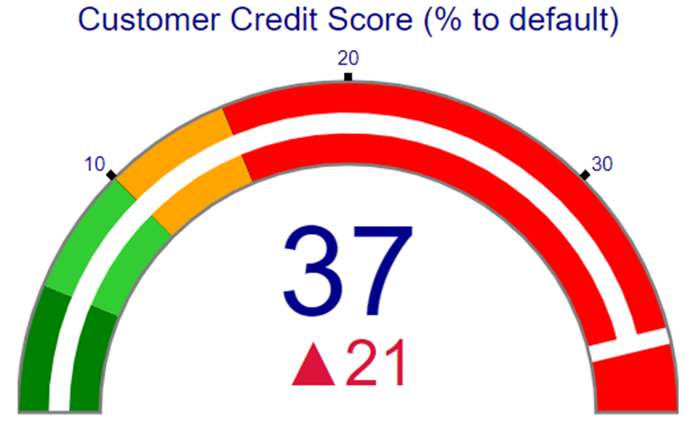
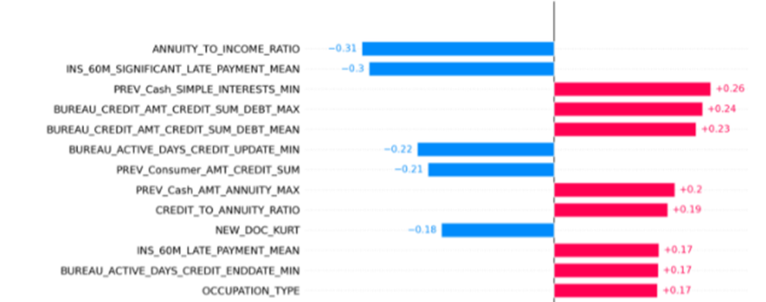
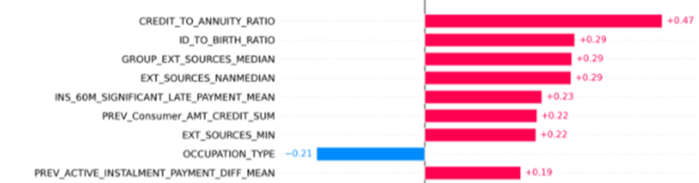
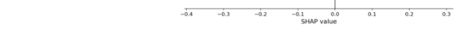

LOCAl interpretability ExAMPLE
Customer_id: 108910
LOAN APPROVED
Customer_id: 109328
LOAN REFUSED

Slide 16
DEPLOYMENT

Slide 17

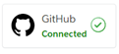

Deployment with Heroku
Heroku is a platform as a service (PaaS) that enables developers to build, run, and operate applications entirely in the cloud.
Build & run ML API
Acces API
Frontend web APP
https://h7o-fastapi-heroku.herokuapp.com/docs
https://h7o-streamlit-heroku.herokuapp.com/

Slide 18
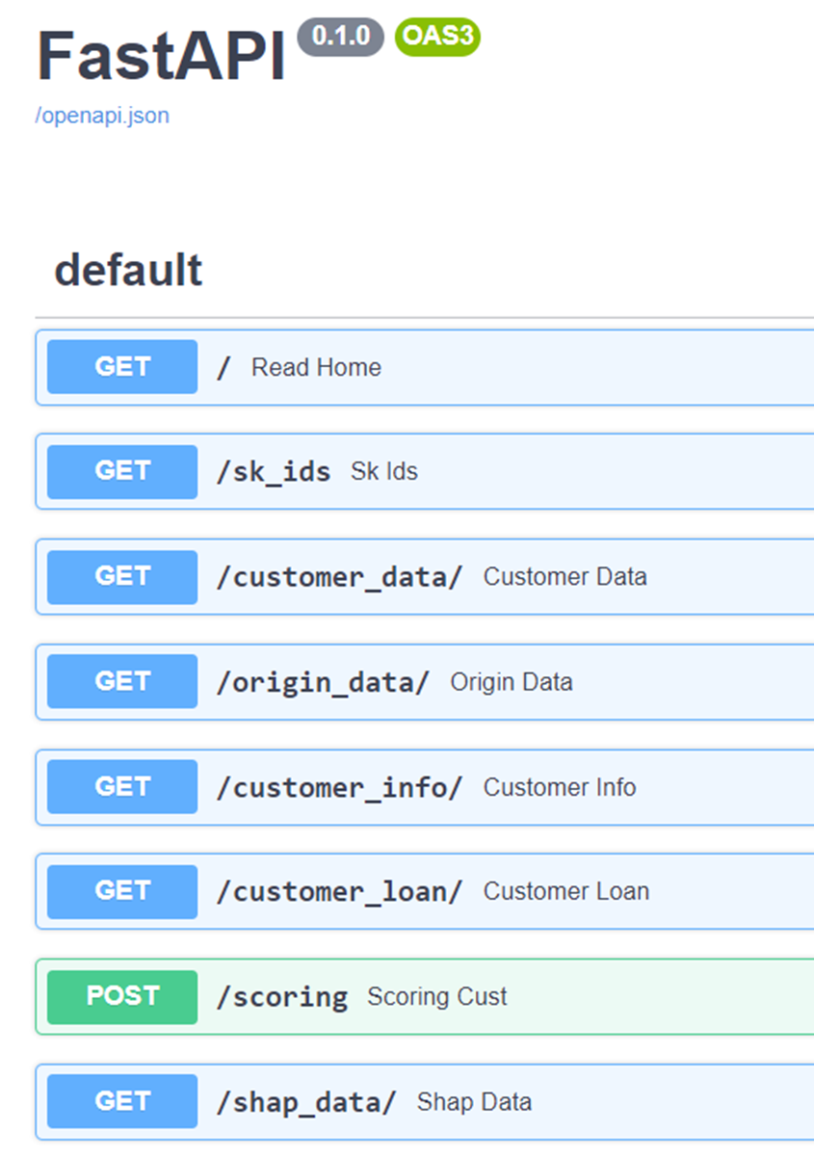
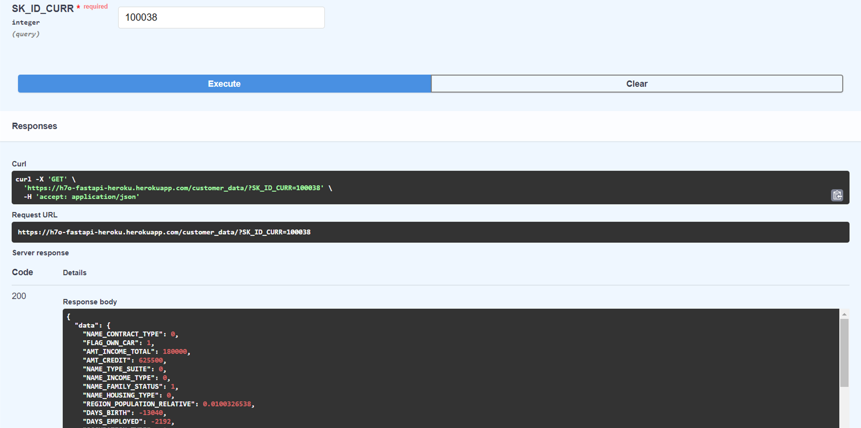
Backend FastAPI
FastAPI is a modern, fast (high-performance), web framework for building application programming interfaces (APIs)
Id customer input returns all requested information
A "path" is also commonly called an "endpoint" or a "route".
STREAMLIT connected

Slide 19
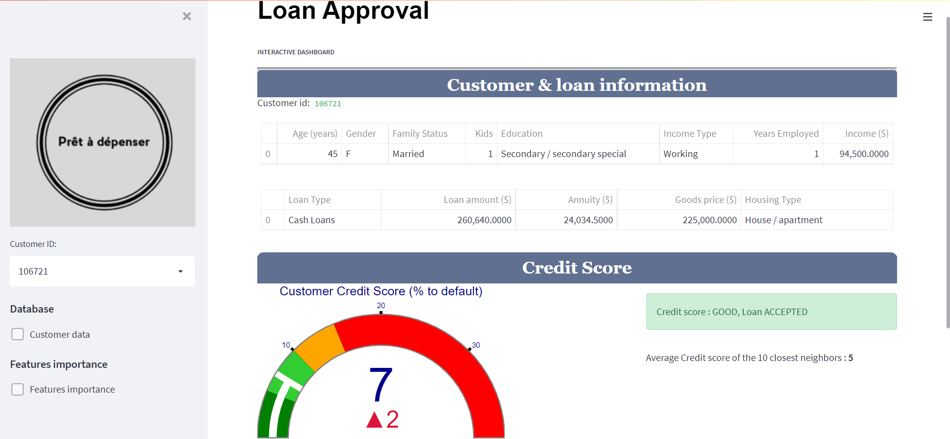
Dashboard via Streamlit

Slide 20
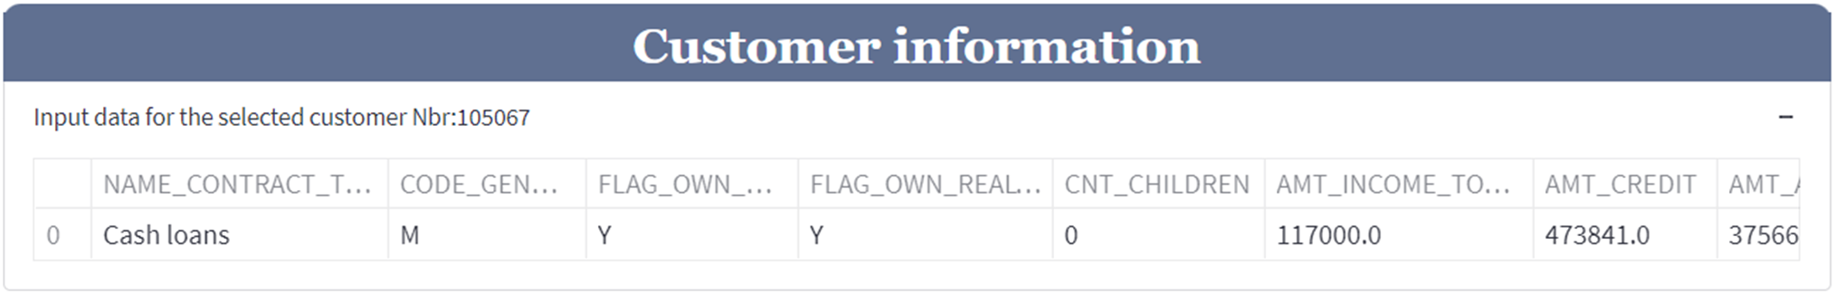
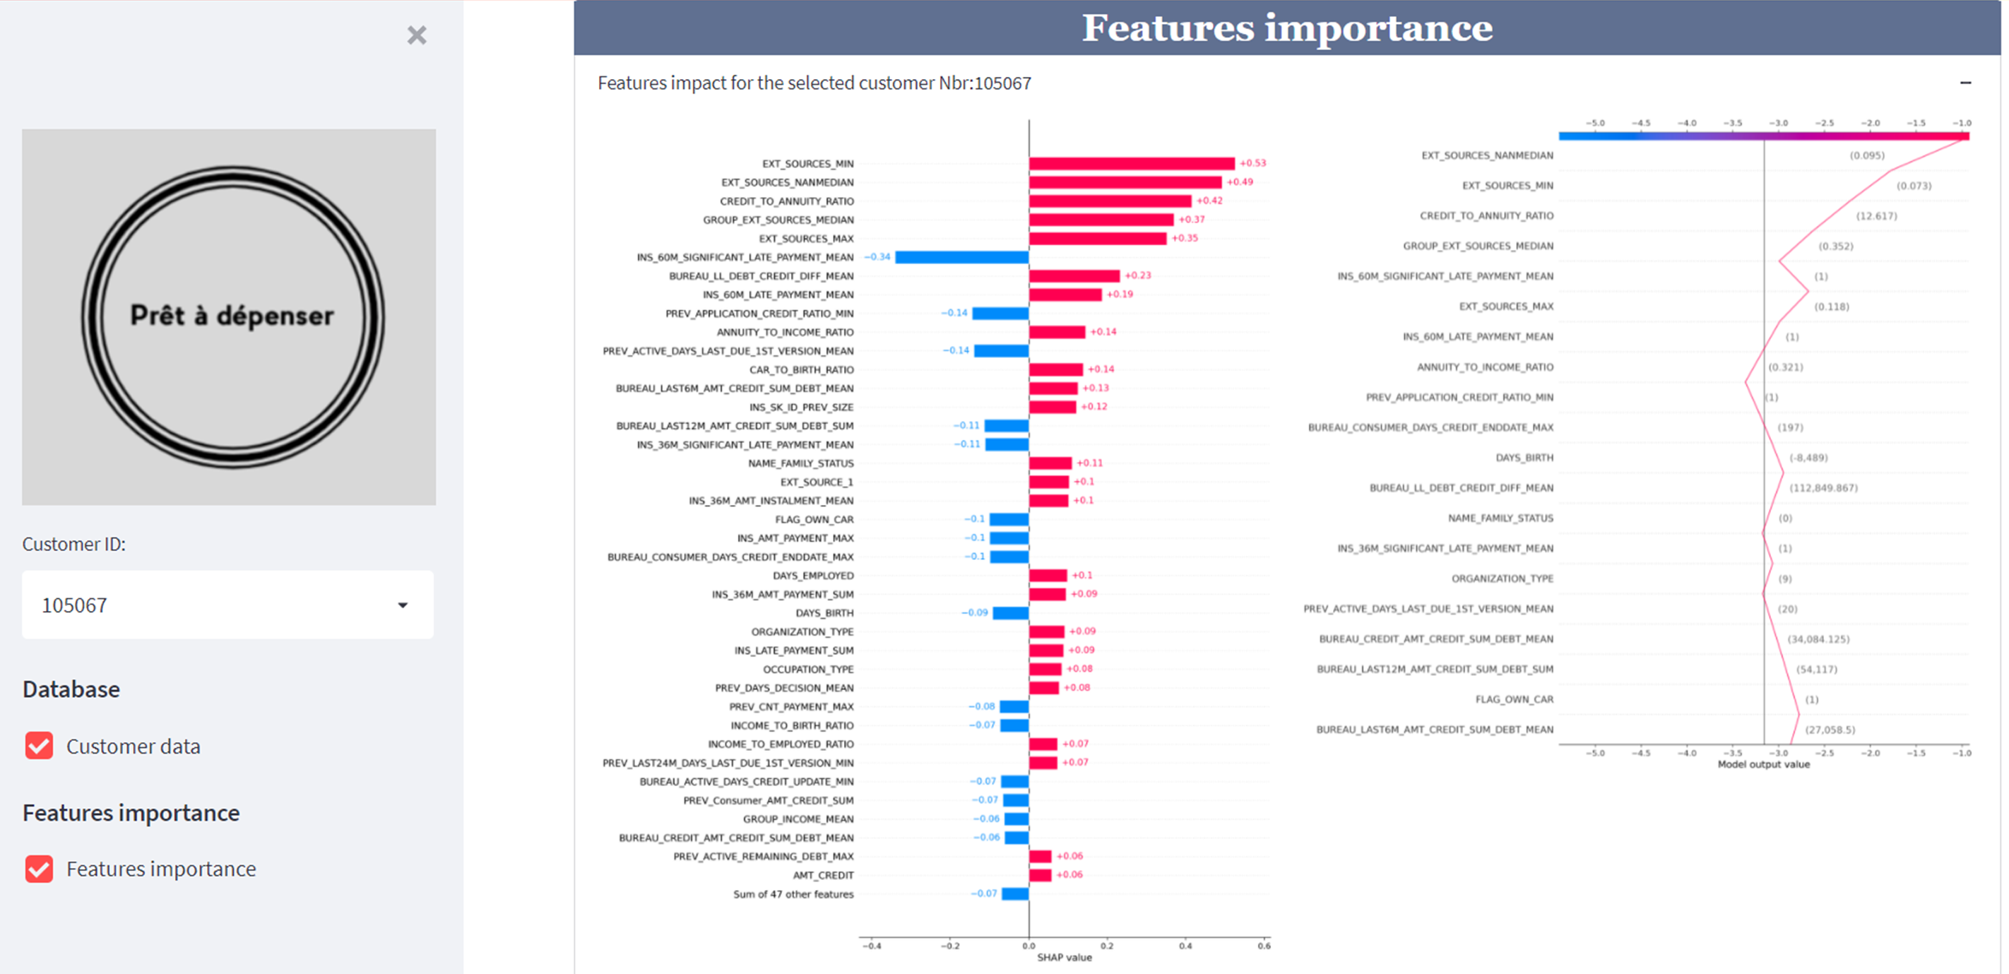
Dashboard via Streamlit

Slide 21
CONCLUSION
Implementation of a scoring model for loan approval
Use of an adapted banking metric proved to be efficient
Back end – FastAPi & FrontEnd - Streamlit
Deployment on Heroku cloud plateform
IMPROVEMENTS
Discuss balance between FN & FP with management to adjust our banking metric
Full range model tests to investigate performance enhancements
Investigate under-sampling or combination under/over-sampling
Add comparison features to dashboard

